Slide 1


Enhanced Pathways to
Oral Health for Women, Infants,
& Children Initiative
May 20, 2025
Notes:
Good afternoon! Thank you for joining us today to learn more about the Illinois Children’s Healthcare Foundation’s new funding opportunity, the “Enhanced Pathways to Oral Health for Women, Infants, and Children Initiative.”
Please note that that this session is being recorded and will be placed on our website shortly after today’s event.

Slide 2
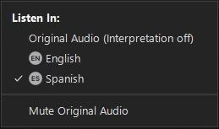

LANGUAGE ACCESS RESOURCE CENTER
Accessing the Interpretation Channel in Zoom
Acceso al Canal de Interpretación de Zoom
When joining the meeting, look for the below options according to the type of device you have.
Al unirse a la reunión, busque las opciones indicadas abajo, de acuerdo al tipo de dispositivo que usted tenga.
Laptop or desktop computer:
Computadora portátil o computadora de escritorio:
DuPage Federation on Human Services Reform
Notes:
Please note that today’s event is supported by Spanish interpretation services.
In just a moment we will be launching an interpretation room for Spanish-speaking attendees.
To access the interpretation room from a laptop or desktop computer, please click the Globe icon that says “Interpretation” at the bottom of the screen and select “Spanish.” Please also select “Mute Original Audio.”
We will now launch the interpretation room and allow a moment for attendees to join that channel.

Slide 3
ILCHF Funding Opportunity:
Enhanced Pathways to Oral Health for Women, Infants, & Children Initiative
Notes:
Thank you again for joining us today!
My name is Zach Wilder and I am the Associate Program Officer at the Illinois Children’s Healthcare Foundation
The purpose of today’s session is to provide an overview of the Enhanced Pathways to Oral Health For Women, Infants, and Children Initiative, review the application process, and answer any questions that you may have.
I am also thrilled to be joined today by leaders from the Illinois Public Health Association and the Illinois Department of Public Health – Oral Health Section who have extensive expertise with supporting and implementing healthcare workforce development initiatives.
ILCHF is proud to be collaborating with these organizations to offer a variety of individualized technical assistance opportunities that support grantees as they enhance access to oral health services for families enrolled in the WIC program.
And I am also excited to see the Illinois Department of Human Services WIC team in attendance today. Thank you so much for joining us!

Slide 4

Agenda
  Overview of the Funding Opportunity
  IPHA: Community Health Worker Training
    Tracey Smith, DNP, CHW
  IDPH: Technical Assistance Offered to Awarded Local Health Departments
    Sherri Foran, RDH, BSDH, MPA, PHDH
  Review of Application Process
  Questions & Answers
Notes:
As we get started I wanted to first provide an overview of today’s agenda.
We will begin by sharing an introduction of the Illinois Children’s Healthcare Foundation. We will then share an overview of the funding opportunity. Next we will turn it over to Dr. Tracey Smith, the Associate Executive Director for Public Health Practice at the Illinois Public Health Association, who will discuss the opportunity to implement Community Health Worker’s into your programs and the process of completing the Illinois Public Health Association’s Community Health Worker 101 training.
Next we will hear from Sherri Foran, the Public Service Administrator with the Illinois Department of Public Health – Oral Health Section, who will discuss the individualized technical assistance offered to awarded organizations. Finally, we will quickly review the application submission process and answer any outstanding questions you may have.
Should you have any questions throughout the course of this event, please feel free to submit them to the Q&A box located at the bottom of your screen.

Slide 5
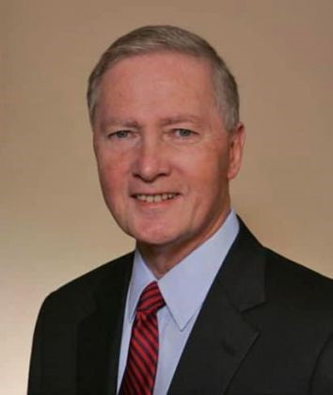

ILCHF’s Founder - Former Attorney General Jim Ryan
ILCHF was created in 2002 through an action of then Attorney General Jim Ryan and an Illinois insurance carrier.
This action and a settlement of approximately $125 million established Illinois’ only private foundation focused solely on the health needs of children across the state.
Former IL Attorney General Jim Ryan
Notes:
The Illinois Children’s Healthcare Foundation was created in December 2002 through an action of then-Attorney General Jim Ryan and an Illinois insurance carrier.
This action and a settlement of approximately $125 million established Illinois’ only private foundation focused solely on the health needs of children across the state.
Since 2004, ILCHF has awarded more than $141 million in grants to organizations working to address the healthcare needs of Illinois children and families.

Slide 6

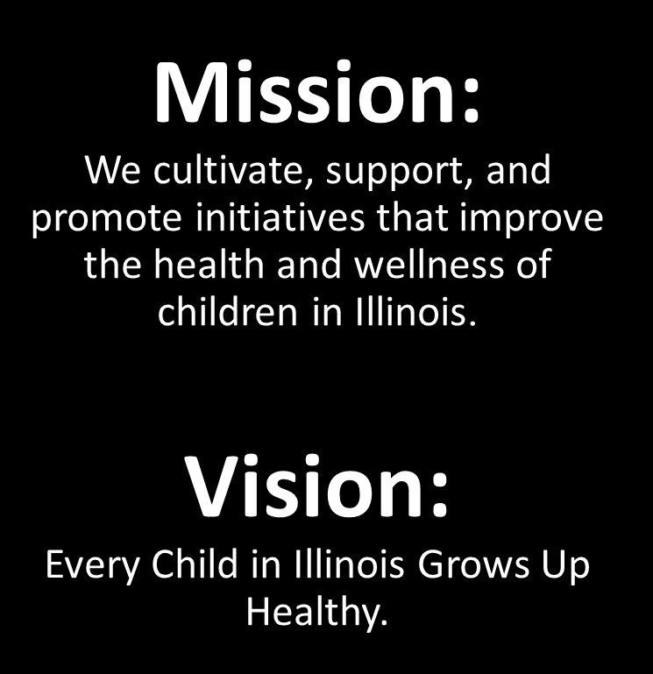

Notes:
Working through grantee partners across the state, the Foundation focuses its grant making on identifying and funding solutions to the barriers that prevent children from accessing the health care they need, with a primary focus on children’s oral health, mental health, and unmet and emerging needs.
The Foundation’s philosophy is that health care must address the whole child, and that the healthcare system in Illinois must be responsive to the needs of all children.
To that end, our mission is to cultivate, support, and promote initiatives that improve the health and wellness of children in Illinois.
All of this is done with the vision that every child in Illinois grows up healthy.

Slide 7
The Need to Enhance Pathways to Oral Healthcare Services
Notes:
Throughout its history, ILCHF has learned from families and communities regarding the challenges they have experienced while navigating complex health care systems.
Many children living in underserved or rural areas experience significant barriers to accessing essential oral health care services. These barriers to accessing oral health care services widen inequities and exacerbate the risk of experiencing painful complications such as tooth aches and dental caries.

Slide 8
Many Children are Experiencing Barriers to Oral Healthcare
According to the most recent Illinois Oral Health Surveillance Brief:
Only...
Nearly...
Less than...
2 in 5
70%
20%
children enrolled in Medicaid have seen an oral healthcare provider in the last 12 months
of children enrolled in Head Start had at unmet oral health needs
of pregnant Medicaid members received at least 1 preventive service before delivery
Source: Illinois Department of Public Health. (2023, Fall). Illinois Oral Health Surveillance Brief. Illinois Department of Public Health. https://dph.illinois.gov/content/dam/soi/en/web/idph/publications/idph/topics-and-services/prevention-wellness/oral-health/oral-health-data/oral-health-surveillance-brief-2018-2022.pdf
Notes:
In fact, according to the most recent Illinois Oral Health Surveillance Brief, only 2 in 5 children enrolled in Medicaid have seen an oral health care provider in the last 12 months, and nearly 70% of children enrolled in the Head Start program have an unmet oral health need.
We also know that further oral health support is also needed for pregnant people. In Illinois, fewer than 1 in 5 expectant individuals enrolled in Medicaid reported receiving at least one preventive or periodontal service during their pregnancy.

Slide 9
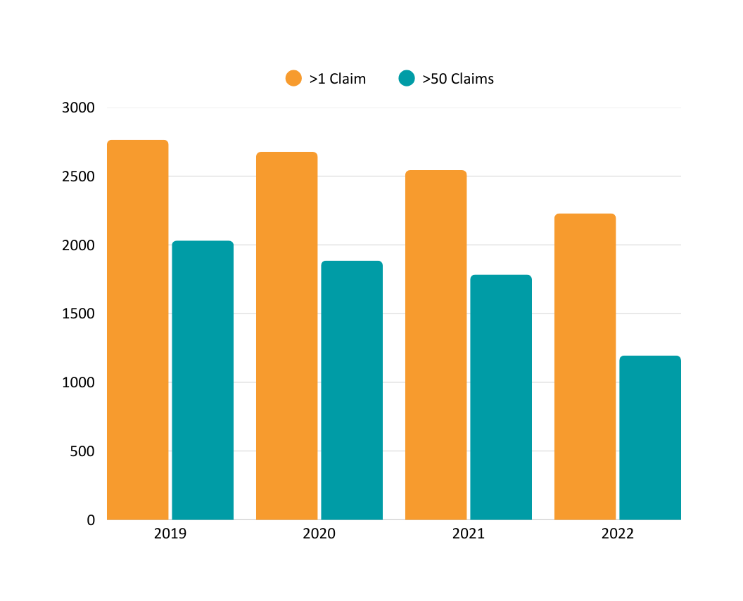
Oral Healthcare Workforce Shortages in Illinois
Number of Illinois dentists participating in Medicaid
More than 2.1 million Illinois residents currently live in an area with a shortage of dental healthcare providers
From 2019-2022:
  Decrease of 537 (19%) Medicaid dentists submitting at least one claim per year
  Decrease of 837 (41%) Medicaid dentists submitting at least 50 claims per year
Illinois Oral Health Surveillance Brief
Source: KFF. (2024, December 31). Dental Care Health Professional Shortage Areas. KFF. https://www.kff.org/other/state-indicator/dental-care-health-professional-shortage-areas-hpsas/?currentTimeframe=0&sortModel=%7B%22colId%22:%22Location%22,%22sort%22:%22asc%22%7D
Notes:
All of this comes at time when Illinois is experiencing serious and concerning oral health workforce shortages.
In fact, more than 2 million Illinois residents currently live in an area with a shortage of dental healthcare providers. What is interesting about this is that Illinois has seen an increase in the number of licensed dentists and dental hygienists over the past 5 years… but what we are also seeing is decrease in the number of dentists who participate in Medicaid.
From 2019 – 2022, the number of dentists who submitted at least 1 Medicaid claim per year fell by 20%, a decrease of more than 500 dentists. And the number of dentists submitting at least 50 claims per year decreased by 41%, a decrease of more than 800 dentists.

Slide 10

Oral Health Challenges Amongst Families Enrolled in WIC
Every month the Illinois WIC program serves:
  124,000 infants & children
  37,000 parents/caregivers
Barriers to care have resulted in children enrolled in the WIC program experiencing significantly higher rates of cavities and lower oral healthcare utilization
Source: Clairborne, D. M., Chen, C., & Zhang, Q. (2022, February). Disparities in Caregiver-Reported Dental Cavities and Toothaches Among Children in the Special Supplemental Nutrition for Women, Infants, and Children (WIC) Program. The Journal of Dental Hygiene, 96(1), 43-54.
Notes:
These poor health outcomes combined with a lack of access to oral healthcare providers disproportionately harm children from lower-income households, including participants enrolled in the Special Supplemental Nutrition Program for Women, Infants, and Children (WIC).
In 2022, the Illinois WIC program served approximately 124,000 infants and children per month at more than 170 clinics throughout the state.
Even with programs such as WIC, children from lower-income households continue to have limited access to dental care services. Such barriers to care have resulted in children enrolled in the WIC program experiencing significantly higher rates of cavities and lower oral health care utilization than the general population.
For example, a 2022 study looked at data from the National Survey of Children’s Health found that children enrolled in the WIC program were 2.25x more likely to have a reported cavity than children who were not eligible to enroll in WIC.
Further support is needed to ensure that every child, baby, and parent/caregiver participating in the WIC program has access to the oral health care they deserve.

Slide 11


Enhanced Pathways to Oral Health for Women, Infants, and Children
Overview
ILCHF is seeking proposals in response to its “ENHANCED PATHWAYS TO ORAL HEALTH FOR WOMEN, INFANTS, AND CHILDREN INITIATIVE” that improve oral health education, patient navigation, and integrated care for families enrolled in the WIC program.
Notes:
With that context, I am proud to present the Enhanced Pathways to Oral Health for Women, Infants, and Children Initiative
ILCHF is seeking proposals that improve oral health education, patient navigation, and integrated care for families enrolled in the WIC program.

Slide 12
Enhanced Pathways to Oral Health for Women, Infants, and Children
Overview
14 two-year grants of up to $40,000 each to Local Health Departments with 1+ WIC clinics
Funding can primarily be directed toward the salaries and professional development of:
  Community Health Workers
  Primary medical providers
i.e. physicians, nurses, physician assistants, etc.
Notes:
This funding opportunity will provide 14 two-year grants of up to $40,000 each to Local Health Departments (LHDs) currently operating 1 or more WIC clinics.
Specifically, grant funding can primarily be directed toward the salaries and professional development of new and/or current Community Health Workers (CHWs) and primary medical providers that would be trained to offer oral health services to infants, children, current or expectant mothers, and parents/caregivers enrolled in the WIC program.

Slide 13

Enhanced Pathways to Oral Health for Women, Infants, and Children
Why Community Health Workers & Primary Medical Providers?
Community Health Workers can:
  Offer case management to identify dental providers who accept Medicaid / CHIP
  Offer basic oral health education and nutritional counseling
Primary Medical Providers can:
  Counsel caregivers on oral health and refer to a dental home
  Identify suspicious lesions that a dentist should evaluate
  Apply fluoride varnish to children ages 5 and under (Medicaid reimbursable)
Notes:
Now you may be asking, why Community Health Workers and Primary Medical Providers?
That’s because these are innovative workforce development approaches that can effectively support the oral health needs of children and families and prevent complications.
For example, while CHWs cannot provide dental care, they can play a crucial role in supporting the oral health of WIC-enrolled families by offering case management to connect patients to dental providers accepting Medicaid or CHIP, offering basic oral health education and nutritional counseling, and advocating for individual health needs.
And primary medical care providers – including physicians, nurses, physician assistants, and others – are uniquely positioned to provide basic preventive oral health care services and dental referrals to infants and young children. This includes counseling caregivers on oral health, and applying and being reimbursed by Medicaid for fluoride varnish applied to children ages five and under.

Slide 14
Enhanced Pathways to Oral Health for Women, Infants, and Children
Technical Assistance
Awarded Local Health Departments would receive individualized technical assistance from IDPH-OHS
Grant funds can also be used to complete IPHA’s CHW 101 training and receive support with integrating new CHW programs
Notes:
There are a lot ways to leverage this funding opportunity to expand access to oral health services for WIC-enrolled families at your Health Departments.
That’s why ILCHF is proud to partner with the Illinois Department of Public Health – Oral Health Section to offer individualized technical assistance to awarded grantees.
You’ll hear directly from IDPH later in this session, but a few examples of assistance provided by IDPH-OHS include, but are not limited to, supporting CHWs in collaboration with IPHA to complete training requirements with an oral health concentration, training nurses or other medical staff to identify unusual or suspicious lesions in the mouth, and offering in-person training to apply fluoride varnish to the teeth of children ages five and under.
Additionally, grant funds can be utilized to cover costs associated with completing IPHA’s CHW 101 Training Program, and offering additional assistance to help your LHD integrate new CHW programs, such as by facilitating hiring opportunities and setting up billing procedures.

Slide 15
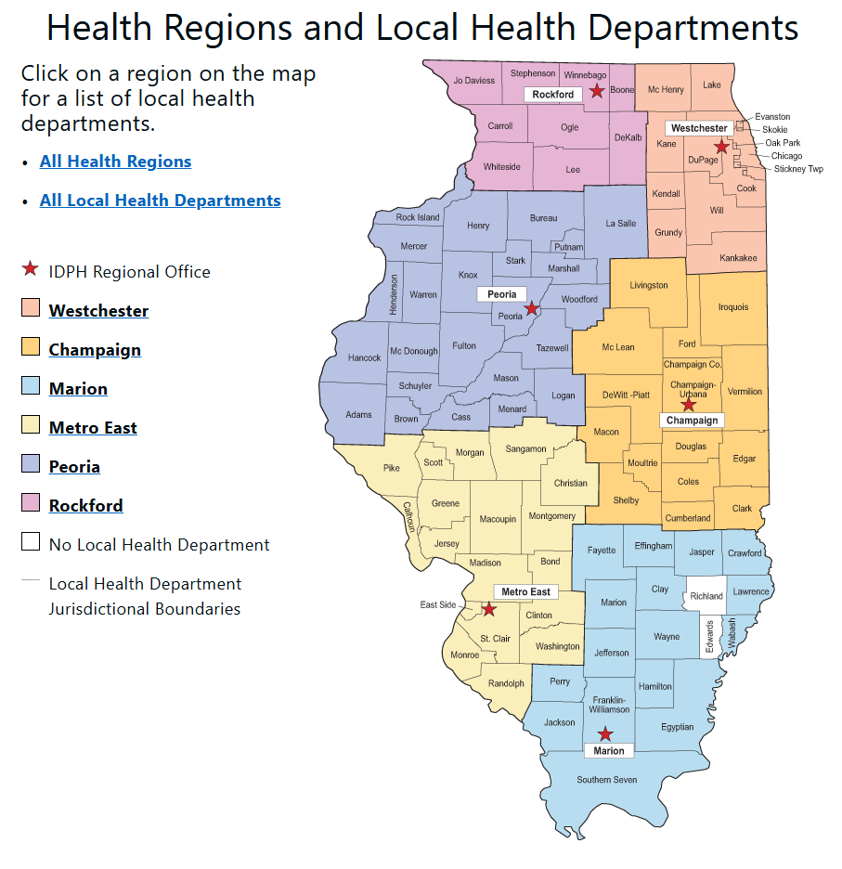
Enhanced Pathways to Oral Health for Women, Infants, and Children
Details & Eligibility
ILCHF intends to award 2 grants to each of the IDPH Health regions
  Note: 2 proposals awarded in City of Chicago and 2 proposals funded in the rest of the Westchester Region
Preference may be given to organizations located in an oral health healthcare workforce shortage area:
  Go to Data.HRSA.gov to learn if your county is located in a dental HPSA
Notes:
Recognizing the importance of supporting oral health initiatives across the state, ILCHF intends to award 2 grants in each of the IDPH health regions.
Please note that in July 2024, IDPH combined its Chicago and West Chicago health regions into a single region. For this initiative, ILCHF intends to fund two proposals each in the City of Chicago and the rest of the Westchester Region.
Please also note that preference may be given to organizations serving a federally designated Dental Health Professional Shortage Area.

Slide 16

Enhanced Pathways to Oral Health for Women, Infants, and Children
Award Announcement & Reporting Requirements
Grant recipients will be announced in:
October 2025
1/2 of grant funds will be disbursed no later than:
December 15th, 2025
Grant period from:
January 1, 2026 - December 31, 2027
Two Reporting Requirements:
- Progress Report on February 28, 2027
- Final Report on February 28, 2028
Notes:
Grant recipients will be announced in October 2025 and grant funds will be disbursed no later than December 15th 2025.
The grant period will be from January 1st, 2026 – December 31st, 2027.
There will be only 2 reporting requirements associated with this grant. A progress report delineating activities, requested project data, and expenditures will be due on February 28, 2027. A final report will be due on February 28, 2028.

Slide 17
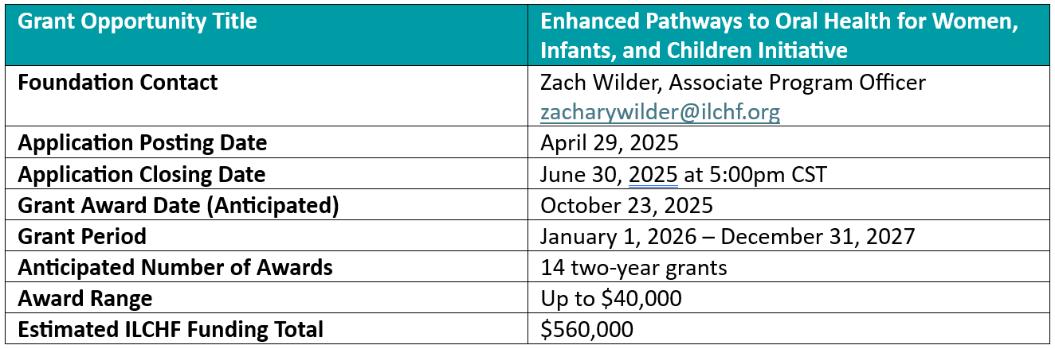
Children’s Nutrition Initiative Renewal 2025
Summary
Notes:
This table summarizes the logistical information related to this funding opportunity. All applications will be due by Monday, June 30, 2025 at 5:00pm CST.
Of course, should you have any questions about the Enhanced Pathways initiative, please do not hesitate to contact me at ZacharyWilder@ilchf.org.

Slide 18
Community Health Worker Training with an Oral Health Focus
Tracey Smith, DNP, CHW
Associate Executive Director for Public Health Practice, IPHA
Notes:
It is now my pleasure to introduce Dr. Tracey Smith who will discuss Community Health Workers and the resources offered by the Illinois Public Health Association.
Dr. Tracey Smith is the Associate Executive Director for Public Health Practice at the Illinois Public Health Association (IPHA). She has been involved in healthcare in numerous roles, allowing her to build skills to engage multiple types of health care providers and customers. She has led programs providing support services to local police systems, schools, healthcare clinics, and community-based organizations through the integration of community health workers into interdisciplinary teams. She was instrumental in developing one of the first CHW training programs in downstate Illinois. She has traveled the state helping organizations move towards being a trauma aware organization and for integrating CHWs into their systems. She is proud to say that for over 15 years she has been a CHW in Illinois.
Dr. Smith, thank you very much for joining us today!

Slide 19

HelpGuideThrive Capacity Center :
A CHW Support Center
Illinois Children’s Healthcare Foundation
Enhanced Pathways to Oral Health for Women, Infants, and Children Iniative
Tracey Smith, DNP, CHW
Illinois Public Health Association
May 20, 2025

Slide 20

CHWS Overview
Definition of a CHW
Evidence/history of CHW integration into Oral Health Practice
What and who makes a great CHW?
Integration Playbook
Sustainability long-term
  Billing Medicaid
Notes:
A community health worker is a frontline public health worker who is a trusted member of and/or has an unusually close understanding of the community served. This trusting relationship enables the worker to serve as a liaison/link/intermediary between health/social services and the community to facilitate access to services and improve the quality and cultural competence of service delivery.
A community health worker also builds individual and community capacity by increasing health knowledge and self-sufficiency through a range of activities such as outreach, community education, informal counseling, social support and advocacy.
This definition was first developed by the CHW Section and codified through APHA policy in 2009.
Results: Out of the 36 articles that met the inclusion criteria, most took place in the United States (n=15) with most published between 2012 and 2019 (12). CHWs were incorporated in programs that focused on access to dental care (n=10), oral health promotion only (9), early childhood caries (8), oral health promotion and services (5), and oral cancer screening (4). Common roles included providing oral health education and behavior change motivation to community members, facilitating utilization of dental services, and the delivery of diagnostic and dental services to community members. Training and outcomes were not consistently described across studies.
Conclusion: CHWs have been used in oral health programs and interventions across a wide range of locations and contexts. The implementation and scaling-up of oral health CHW programs requires appropriate provision of training as well as community embedded monitoring and evaluation structures based on rigorous methods with clearly defined outcomes.
Keywords: Health promotion
; community health workers; dental care delivery
Community Dent Health
. 2021 Aug 31;38(3):198-208.
doi: 10.1922/CDH_00370Garcia11.
A scoping review of the roles, training, and impact of community health workers in oral health
D T Garcia ¹, J A Lawson ¹, E R Brody ², S C McKernan ³, S E Raskin ⁴, N R Arauz ¹, M Mosavel ¹, T H Brickhouse ⁵
Affiliations Expand
PMID: 34029018
DOI: 10.1922/CDH_00370Garcia11

Slide 21

IPHA/IDPH CHW Training Program
Training Program
Hours
Scheduling
Alignment with anticipated state
certification
Cost
Certification of Completion

Slide 22


Join our private LinkedIn CHW Group!
Search “Illinois Community Health Workers” on LinkedIn and request to join.
We will be sharing upcoming CHW events, trainings, and upskilling.
Connect with other CHWs in Illinois.
Share your CHW events, stories, and accomplishments.
Email: chwsupport@ipha.com or tsmith@ipha.com
Visit our CHW website at helpguidethrive.org.
Upcoming Trainings
Resources
Job Postings
Upskilling and more!

Slide 23
Technical Assistance Offered to Awarded Local Health Departments
Sherri Foran, RDH, BSDH, MPA, PHDH
Public Service Adminstrator, IDPH - OHS
Notes:
Thank you Dr. Smith for that very informative presentation and for the support IPHA offers to our state’s CHWs.
It is now my pleasure to introduce Sherri Foran who will discuss the technical assistance opportunities provided to awarded local health departments.
Sherri Foran is a licensed dental hygienist who has worked with the Illinois Department of Public Health's Oral Health Section for over nine years. She provides oral health education and training for providers at local health departments, federally qualified health centers, and academic associations. She currently oversees the quality and safe delivery of preventive dental care in the HFS All-Kids School-Based Oral Health Programs and the Oral Health Promotion Grant. Her intent is to share her expertise and passion for oral health with others, inspiring the next generation of licensed dental hygienists.
Sherri, thank you very much for joining us today!

Slide 24
IDPH Oral Health Section Collaboration with ILCHF to Provide Technical Assistance
Customized to meet the needs of the community served, virtually or in person
Why?
Dental Caries is the #1 childhood disease
Solution?
Prevention!

Slide 25
Increased Efficiency and Proactive Problem Solving
Technical assistance can help streamline activities and
deliverables, freeing up valuable time for a higher-level focus on
patient care and education.
Facilitation of the CHW Training/IPHA.
Guidance on Fluoride Varnish Training/Smiles for Life or
Bright Smiles from Birth.
Timeline study of workflow.
Instruction on motivational interviewing.
Talking points for hesitant parents on the benefits of topical
fluoride and how it differs from systemic fluoride.

Slide 26
Enhanced Collaboration and Shared Best Practices
Facilitating communication and collaboration among
Grantees could enhance outcomes.
What works well in one region may work well in other areas.
Hands-on training of fluoride varnish application can
improve the buy-in of medical providers to oral health
services.

Slide 27
Reduced Costs and understanding the Nuances of WIC Restrictions
By streamlining operations, technical assistance can help
reduce wasteful use of resources without compromising
quality.
WIC time must be protected.
How do we fit this into our schedule?
Use of the timeline study to navigate how oral health
services can be provided.

Slide 28
Enhanced Pathways to Oral Health for Women, Infants, and Children Initiative
Application Process
Notes:
Thank you Sherri for that overview. The Foundation is really excited to be partnering with both IDPH and IPHA to provide flexibility and support local health departments in leveraging this funding opportunity to effectively implement additional supports for the children and families that you all serve.
Before we move to a Q&A session I wanted briefly discuss the application process for this RFP.

Slide 29

Prior to Starting the Application Process
Make sure you have your organization’s Employer Identification Number (EIN) from either the most recent IRS Form 990 or IRS Determination Letter.
Notes:
Prior to accessing the application, you must have your organization’s Employer Identification Number (EIN) which is available on the most recent IRS form 990 or IRS Determination letter.

Slide 30
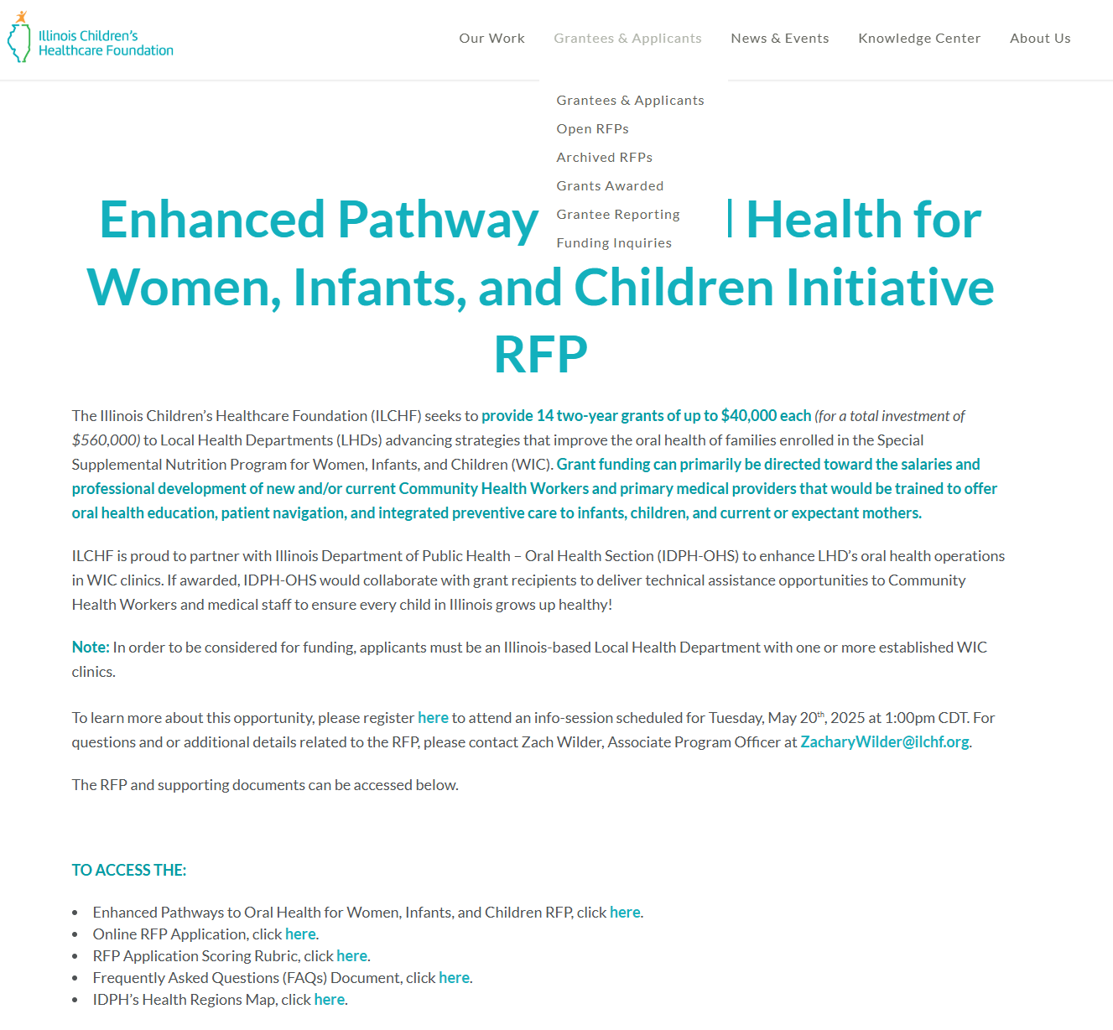
Accessing the Application
1. Go to ILCHF.org
2. Click “Grantees & Applicants”
3. Select “Open RFPs”
4. Scroll to the “Enhanced Pathways to Oral Health Initiative”
5. Click “Online RFP Application”
Notes:
To access the application, go to ILCHF.org, click grantees & applicants at the top of the screen, and then select Open RFPs. Once on the Open RFPs page scroll down to the Enhanced Pathways to Oral Health initiative and click “On-Line RFP Application.”

Slide 31
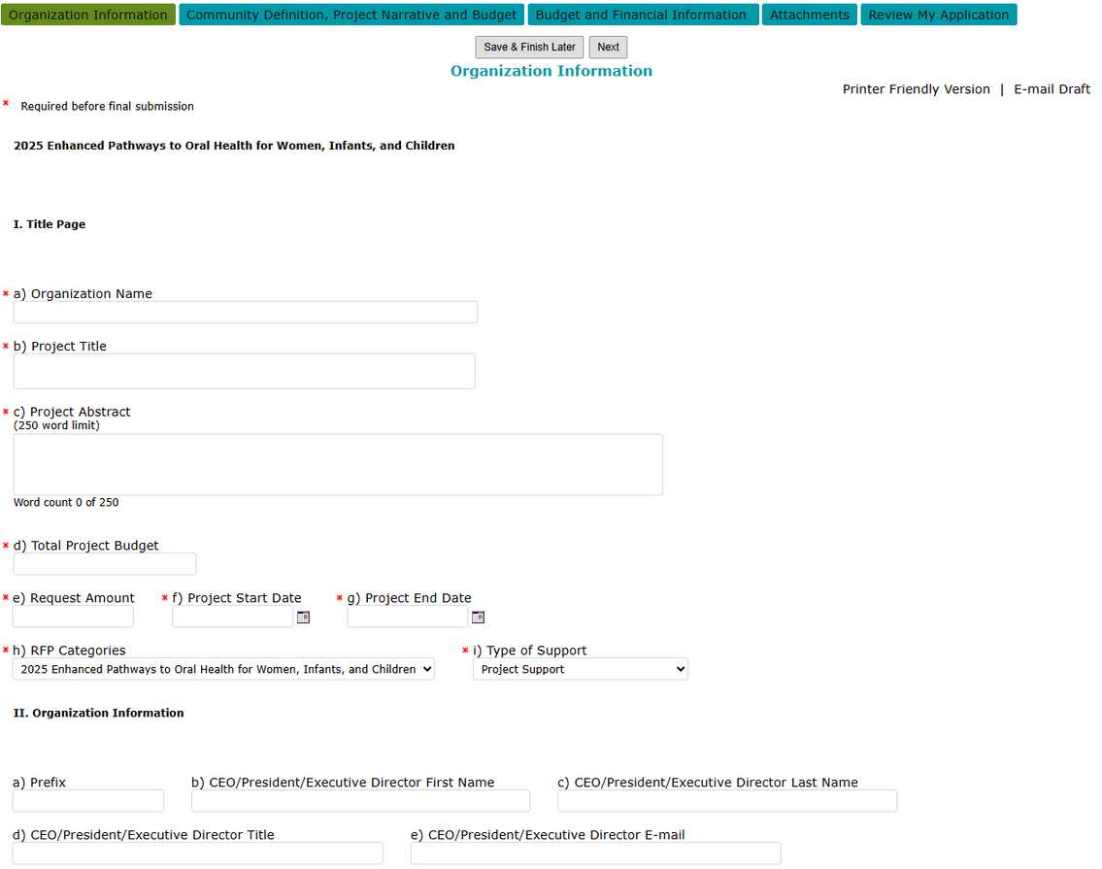
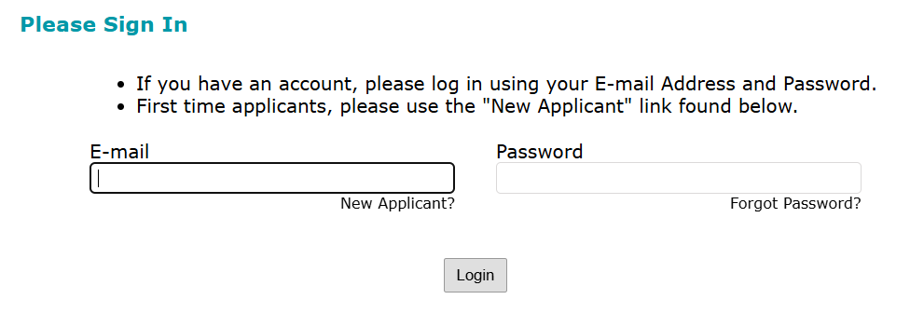
Accessing the Portal
1.
3.
2.
Notes:
Once you access the portal, you will be prompted to enter log-in information. If you are a returning applicant with an account you can simply enter your email address and password. If you are a new applicant you can select “New Applicant” which will bring you to a page where you can set up an account. Please note that only one person can access the application per organization and enter information in our online portal.
After entering this information you will be brought to the next screen where you will be asked to enter your tax id. This is how we can ensure that only one applicant is the lead per application.
Once that information is entered you will be brought to the next screen where you will gain access to the online application portal. As you can see, there are tabs for you to navigate and enter the requested information on the webpage. Note that there is an option to save and continue working on the application at a later time. You will also be able to review the total application prior to submitting.

Slide 32

Core Components of the Application
1. Organization Information
2. Community Definition
3. Project Narrative
4. Budget & Budget Narrative
5. Financial Information
Notes:
Applicants will be required to complete the following sections
O Organization information, including a brief project abstract, organizational background, and contact information.
O A community definition section that includes details for the geographic area and child population that you plan to serve
O A project narrative that describes how funding for this grant will be used and the need that the project will address
O Budget and budget narrative
O And then additional financial information

Slide 33
Application Process
Community Definition
  Primary geographic area served
  All counties served by the project
  Describe the demographics of the community to be served. Data provided could include, but is not limited to, socioeconomic status, languages spoken, unemployment rates, school district spending per pupil, etc. Discuss relevant health data if known for children and adults (250-word limit)
Notes:
To provide a little more information about the Community Definition, we are asking that you define the geographic area served, the counties served by the project, and briefly describe the demographics of the community to be served.
Data provided can include, but is not limited to, socioeconomic status, languages spoken, insurance coverage, unemployment rates, school district spending per pupil, etc. We are asking that you discuss relevant health data if known for children and adults.

Slide 34
Application Process
Project Narrative
  Please describe the WIC-enrolled population specific to the geographic area to be served and the oral health needs your organization plans to address (500-word limit)
  Please describe how you propose to use up to $40,000 over two years to enhance access to oral health resources for WIC-enrolled families (500-word limit)
  Please describe how the proposed project has been specifically designed to address the problem and the likelihood - based on prior relevant research, as feasible - that it will successfully do so (500-word limit)
Notes:
For the Project Narrative, we are asking that you describe the WIC-enrolled population that would be served and the specific oral health needs your organization would address
We are also asking how you propose to use up to $40,000 over two years to enhance access to oral health resources for WIC-enrolled families.
We are also interested to learn how the proposed project was designed and the likelihood – based on relevant evidence or research – that the project will successfully support infants, children, and parents/caregivers

Slide 35
Application Process
Project Narrative
  Please describe how you will track the progress of the project (500-word limit)
  Please describe how you envision the project being sustained over the long-term (500-word limit)
Notes:
Finally, we will ask how you will track progress of the project and how you envision it being sustained beyond the grant period

Slide 36
Application Process
Budget & Financial Information
  Complete ILCHF’s two-year budget template. Examples of eligible costs include:
    Staff time
    Salaries for CHWs and/or primary medical providers
    Professional development and training expenses
    Travel time
    Materials/supplies
  Provide a budget narrative. Delineate details associated with the budget, clarify the calculations leading to the budget numbers, and provide details that do not fit within the budget template
Notes:
With regards to the budget and financial information, we will ask that you complete ILCHF’s two-year budget template and provide a budget narrative that delineates details associated with the budget, clarifies calculations leading to the budget numbers, and provides details that do not fit within the budget template. For every line item that you are requesting funds for there should be an explanation as to how those funds will be used.

Slide 37
Application Process
Attachments
  The Officer’s Certification Form signed by the CEO/President or Department Chair
  IRS Letter of Exemption
  Most recent IRS Form 990
  Most recent AG IL 990
  Most recent audited financial statements
  Board of Directors list
If one or more documents are not applicable for your organization, please attach a note in its place explaining why the document cannot be provided.
Notes:
Finally, we will ask that you submit a:
•Officer’s Certification Form signed by the CEO/President or Department Chair
•IRS Letter of Exemption indicating you are a non-profit organization
•Most recent IRS Form 990
•Most recent AG IL 990
•Most recent audited financial statements
•Board of Directors list
We recognize that many Local Health Departments are not required to file one or more of these documents. If any of these items do not apply to your organization, please attach a note in its place that briefly explains why the document won’t be provided.

Slide 38
Technical Assistance
Technical assistance will be provided by Illinois Children’s Healthcare Foundation located at:
Illinois Children’s Healthcare Foundation
1200 Jorie Boulevard, Suite 301
Oak Brook, IL 60523
Phone: 630.571.2555
Fax: 630.571.2566
www.ilchf.org
For questions related to Oral Health Initiatives, please contact:
Zach Wilder, Associate Program Officer zacharywilder@ilchf.org
For technical assistance related to this RFP, please contact:
Nedranae Hunt, Senior Manager of Grants and Administration nedranaehunt@ilchf.org
Notes:
If you have any questions at any point of this process please do not hesitate to contact us. We are here to help and want to support you in submitting the best application possible on behalf of your organization.
If you have any questions about this initiative, please feel free to contact me at ZacharyWilder@ilchf.org.
If you have any technical questions related to applying for this grant, please contact our Senior Manager of Grants and Administration, Nedranae Hunt, at NedraaneHunt@ilchf.org.

Slide 39


Thank You!
Any Questions?
Notes:
With that, thank you again for joining us. I would love to take the rest of this session to answer any questions that you may have! If you have not already, please feel free to submit your questions to the Q&A box located at the bottom of your screen.
As we near the end of this session, I want to quickly to launch two polls to learn of your interest to apply for this opportunity.
The first poll will ask if you are planning to submit an application? Launch Poll.
The second poll will ask to what degree this information session increased your understanding about the Enhanced Pathways to Oral Health for Women, Infants, and Children application process.

