Slide 1
Bright Minds, Bright Smiles:
Mental and Oral Health Integration Initiative RFP
March 24, 2026
Notes:
(Marissa)
Hello everyone and thank you for joining us today to learn more about the Illinois Children’s Healthcare Foundation’s new funding opportunity, the “Bright Minds, Bright Smiles: Mental and Oral Health Integration Initiative.”
We have a few logistical items to address before we begin our information session today.
First, please note that that this session is being recorded and will be placed on our website shortly after today’s event. Secondly, everyone’s mic has been muted during this time to minimize all background noise.
Next Slide…

Slide 2
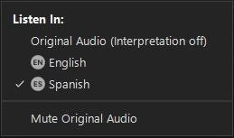

LANGUAGE ACCESS RESOURCE CENTER
Accessing the Interpretation Channel in Zoom
Acceso al Canal de Interpretación de Zoom
When joining the meeting, look for the below options according to the type of device you have.
Al unirse a la reunión, busque las opciones indicadas abajo, de acuerdo al tipo de dispositivo que usted tenga.
Laptop or desktop computer:
Computadora portátil o computadora de escritorio:
DuPage Federation on Human Services Reform
Notes:
(Marissa)
We are also offering interpretation services for our Spanish-speaking attendees today.
To access the interpretation room from a laptop or desktop computer, please click the Globe icon located at the bottom of your screen that is entitled “Interpretation” and select “Spanish.” In addition, please select “Mute Original Audio.”
We will now launch the interpretation room and allow a moment for attendees to join that channel.
Next Slide

Slide 3

Agenda
Overview of the “Bright Minds, Bright Smiles” Funding Opportunity
Review of Application Process
Questions & Answers
Notes:
(Marissa)
Good Afternoon and thank you again for joining us for the Bright Minds, Bright Smiles: Mental and Oral Health Integration Initiative information session. We are glad that you can join us today and we look forward to sharing this exciting initiative with you. My name is Marissa Sanders, and I am the Senior Program Officer for Oral Health & Other initiatives.
Our goal today is to provide you with background information regarding the ILCHF, the purpose of this grant initiative, and detailed information regarding this funding opportunity and the application process. In addition, we want to ensure we answer any question that you may have so we will dedicate time at the end of the informational session to answer questions. Please feel free to enter your questions into the Q&A function located at the bottom of your screen throughout the session, and we will answer them at the designated time.
With this in mind, we will move ahead with a little more about our organization…

Slide 4
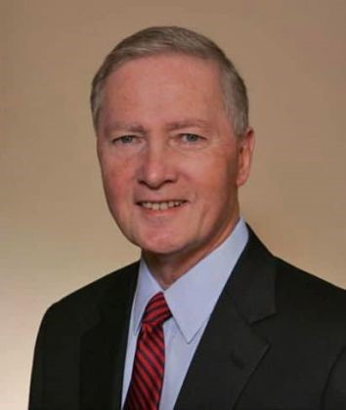
ILCHF’s Background
ILCHF was created in 2002 through an action of then Attorney General Jim Ryan and an Illinois insurance carrier.
This action and a settlement of approximately $125 million established Illinois’ only private foundation focused solely on the health needs of children across the state.
Former IL Attorney General Jim Ryan
Notes:
(Marissa)
The Illinois Children’s Healthcare Foundation was created in December 2002 through an action of then-Attorney General Jim Ryan and an Illinois insurance carrier.
This action and a settlement of approximately $125 million established the Illinois Children’s Healthcare Foundation, Illinois’ only private foundation focused solely on addressing the health needs of children across the state.
Since 2004, ILCHF has awarded approximately $149 million through nearly 900 grants to more than 300 organizations working to address the healthcare needs of Illinois children and families across the state.

Slide 5

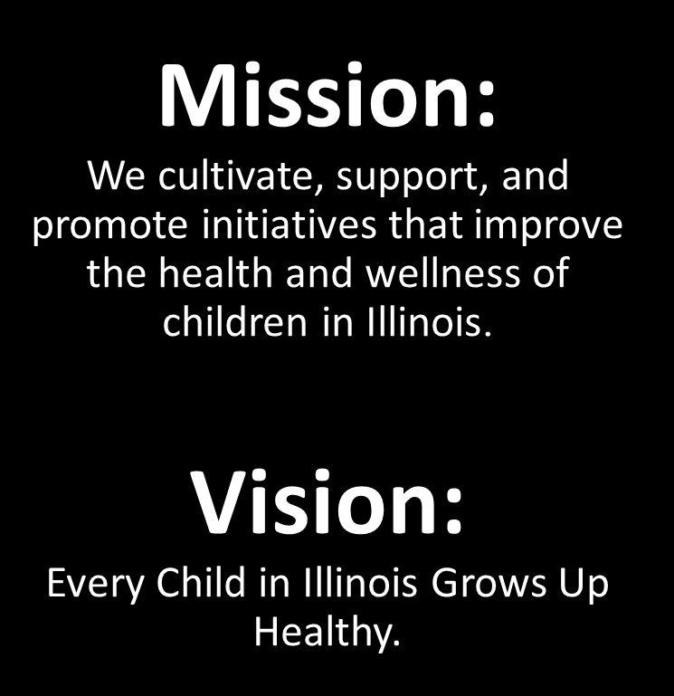

Notes:
(Marissa)
The ILCHF’s singular vision is to ensure every child in IL grows up healthy; which has been our north start since our inception in December 2022.
This vision directly informs our mission which is to cultivate, support, and promote initiatives that improve the health and wellness of children in Illinois.
It also informs our philosophy which is that health care must address the whole child, and that the healthcare system in Illinois must be responsive to the needs of all children.
Now that you are more familiar with us, my colleague Christine Brambilla will share information about what inspired us to create this particular funding opportunity. Christine…

Slide 6
Bright Minds, Bright Smiles:
Mental and Oral Health Integration Initiative RFP
Notes:
(Christine),
Good afternoon everyone, my name is Christine Brambila and I am the senior program officer for mental health here at the foundation. I will be briefly walking you through the federal context that inspired the Bright Minds, Bright Smiles, Mental and Oral Health Integration Initiative RFP.

Slide 7
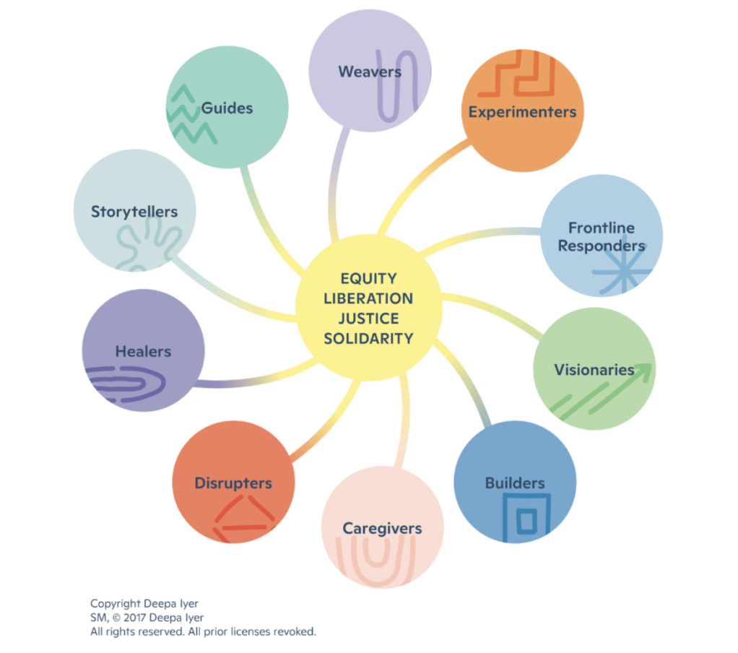
The Purpose of this RFP
Current Ecosystem
  H.R.1’s impact on Medicaid
  Impact on Illinois children and families
  Impact on Illinois providers
ILCHF’s Response to the Current Ecosystem
  Commitment to Ecosystem Responsiveness
  Partner and Community Voices
Notes:
(Christine)
Cuts in federal funding will put pressure on the state budget, which could lead to reduced services and enrollment, as the state cannot make up the funding gap.
Cuts $1 trillion from Medicaid and CHIP
Policy changes due to HR 1 include:
Rural Health Transformation Program-Illinois awarded funding.
Narrowed the definition of “qualified aliens”, impacting misinformation about eligibility across immigrant communities.
Implementing work requirements
6-month eligibility redeterminations for ACA adults.
2025-Illinois Children’s Healthcare Foundation has been listening deeply. Meeting with oral health providers, behavioral health providers, grantees, hosting convenings with peers in philanthropy and community partners.
In 2026, the Illinois Children’s Healthcare Foundation board of directors unanimously voted to approve $6 million of funding over the next three years in ecosystem responsive funding.

Slide 8
Loss of Coverage for Children and Families
Cuts due to H.R.1 could result in loss of coverage for 500,000 IL residents.
1,428,125 children were covered by Medicaid in IL in FY 2025.
IL could face up to $51 million in funding cuts over the next decade.
Nearly 40% of children in Illinoisans who experienced major depressive episodes were unable to receive mental health care.
Only 41.2% of Medicaid enrolled children 0-20 years of age receive preventive or oral health service.
Sources:
Children’s Behavioral Health Transformation Initiative (2023). BluePrint for Transformation
Blueprint for Transformation: A Vision for Improved Behavioral Healthcare for Illinois Children
Illinois Department of Public Health. (2024). Illinois Oral Health Surveillance Brief – Winter 2024.
oral-health-surveillance-brief-2018-2023.pdf
Notes:
(Christine)
44% of Illinois Medicaid customers are children.
Increased Risk of Uninsured Children: When parents lose coverage, children are more likely to become uninsured as well, a phenomenon known as the "chilling effect".
Reduced Access to Developmental Services: Children may lose access to critical services guaranteed by Medicaid's Early and Periodic Screening, Diagnostic and Treatment (EPSDT) benefit, including vaccinations, well-child checkups, hearing, vision, and dental care.
School Support Impacts: If parents lose coverage, schools often see increased demand for services as they attempt to fill the gaps in children's healthcare and support.
Organizations were just emerging to a point of stability, in the post-covid era. We know that if an organization closes its doors, it creates a significant gap in the systems of support children and family need.

Slide 9

Bright Minds, Bright Smiles Initiative RFP
ILCHF is seeking proposals in response to its “BRIGHT MINDS, BRIGHT SMILES: MENTAL AND ORAL HEALTH INTEGRATION INITIATIVE” that sustain and enhance coordination of existing children’s mental or oral health programs in Federally Qualified Health Centers and (FQHCs), Local Health Departments (LHDs), schools offering healthcare services, or community-based organizations (CBOs).
Notes:
(Zach)
Good afternoon everyone. My name is Zach Wilder and I am the Program Officer of Children’s Health at ILCHF.
With that context, I am proud to present the “Bright Minds, Bright Smiles: Mental and Oral Health Integration Initiative.”
ILCHF is seeking proposals that sustain and enhance coordination of existing children’s mental or oral health programs in safety-net settings, such as Federally Qualified Health Centers, FQHC Look-Alikes, Local Health Departments, schools offering healthcare services, or community-based organizations (CBOS).

Slide 10
Bright Minds, Bright Smiles Initiative RFP
20 three-year grants of up to $300,000 each to:
1) Federally Qualified Health Centers/Federally Qualified Health Center Look Alikes, Local Health Departments, schools offering healthcare services, or community-based organizations.
2) Organizations currently offering mental health and/or oral health services to children between the ages of 0 and 21 who are enrolled in Medicaid.*
*Applicants are not required to offer both children’s mental health and oral health services to be eligible for funding.
Notes:
(Zach)
This funding opportunity will provide 20 three-year grants of up to $300,000 ($100,000 per year) to eligible safety-net organizations that improve access to existing mental health services, oral health services, or both for children enrolled in the Medicaid program.
In order to be eligible for funding, your organization must currently offer either mental health or oral health services, or both, to children enrolled in the Medicaid program. Please note that applicants are not required to offer both children’s mental and oral health services to be eligible for funding – nor are you required to submit a proposal detailing how funding will support both oral and mental health services. With that said, applications that propose strategies integrating both mental and oral health will also be considered.

Slide 11
Important Definitions
What is the healthcare “safety net” mentioned in the application?
  For this initiative, ILCHF defines the healthcare safety net as providers and entities serving as the default system of care for individuals who are un- or underinsured, Medicaid beneficiaries, or are from vulnerable communities requiring special services.
What “community-based organizations” are eligible to apply?
  CBOs are local public or private nonprofit organizations that are driven by community residents and address various needs within their community by providing wide-spread services and resources.
Notes:
(Zach)
There are some important definitions that I would like to cover as you begin to think about submitting a proposal to this initiative.
First, what is the healthcare “safety net” mentioned throughout the application? We know that there are several definitions of the safety-net, but for this initiative ILCHF is defining it as providers and entities serving as the default system of care for individuals who are un- or underinsured, Medicaid beneficiaries, or are from vulnerable communities requiring special services. Providers that offer healthcare services in the safety net include, but are not limited to, certified safety net hospitals, community health centers, federally qualified health centers, certified community behavioral health clinics, community mental health centers, local health departments, and schools offering healthcare services.
Next, what “community-based organizations” are eligible to apply? Community-based organizations (CBOs) are local public or private nonprofit organizations that are driven by community residents and address various needs within their community by providing widespread services and resources.
Examples of community-based organizations that are eligible to apply for this grant opportunity include, but are not limited to, care coordination and support organizations, community-behavioral health clinics, mobile dental clinics, community health coalitions, and others serving children who currently enrolled in Medicaid.
If you have any questions about your organization’s eligibility for this grant opportunity, please contact ILCHF. We will share our contact information at the end of this webinar.

Slide 12
Some Examples of Potential Projects
Supporting ongoing current mental or oral health services through direct service provision to children.
Acquiring additional equipment or completing minor construction projects to enhance the array of mental health services or oral health services provided to children.
Hiring and/or training community health workers, care navigators, or care coordinators to assist families with accessing mental or oral health services and resources.
Delivering mental or oral health education and integrated preventive care services to children and parents/caregivers during primary care visits.
Co-locating mental or oral health services in primary care settings, schools, or community settings where children spend a significant amount of time.
Establishing linkages between oral and mental health services in co-located settings.
Enhancing family referrals to mental or oral health service providers accepting Medicaid.
Expanding a linguistically and culturally representative workforce that reflects community demographics.
Addressing barriers to accessing and utilizing mental health or oral health services.
Notes:
(Zach)
There are a lot of ways to leverage this funding opportunity to sustain and enhance existing mental health services or oral health services.
Here we have some examples of potential projects that would be eligible for funding, but please note that this is not an exhaustive list. Examples include:
Supporting ongoing current mental or oral health services through direct service provision to children.
Acquiring additional equipment or completing minor construction projects to enhance the array of mental health services or oral health services provided to children.
Hiring and/or training community health workers, care navigators, or care coordinators to assist families with accessing mental or oral health services and resources.
Delivering mental or oral health education and integrated preventive care services to children and parents/caregivers during primary care visits.
Co-locating mental or oral health services in primary care settings, schools, or community settings where children spend a significant amount of time.
Establishing linkages between oral and mental health services in co-located settings.
Enhancing family referrals to mental or oral health service providers accepting Medicaid.
Expanding a linguistically and culturally representative workforce that reflects community demographics.
Addressing barriers to accessing and utilizing mental health or oral health services.
If any of these ideas sound like they could benefit your organization and support the work you are doing for our state’s children, please consider applying!

Slide 13
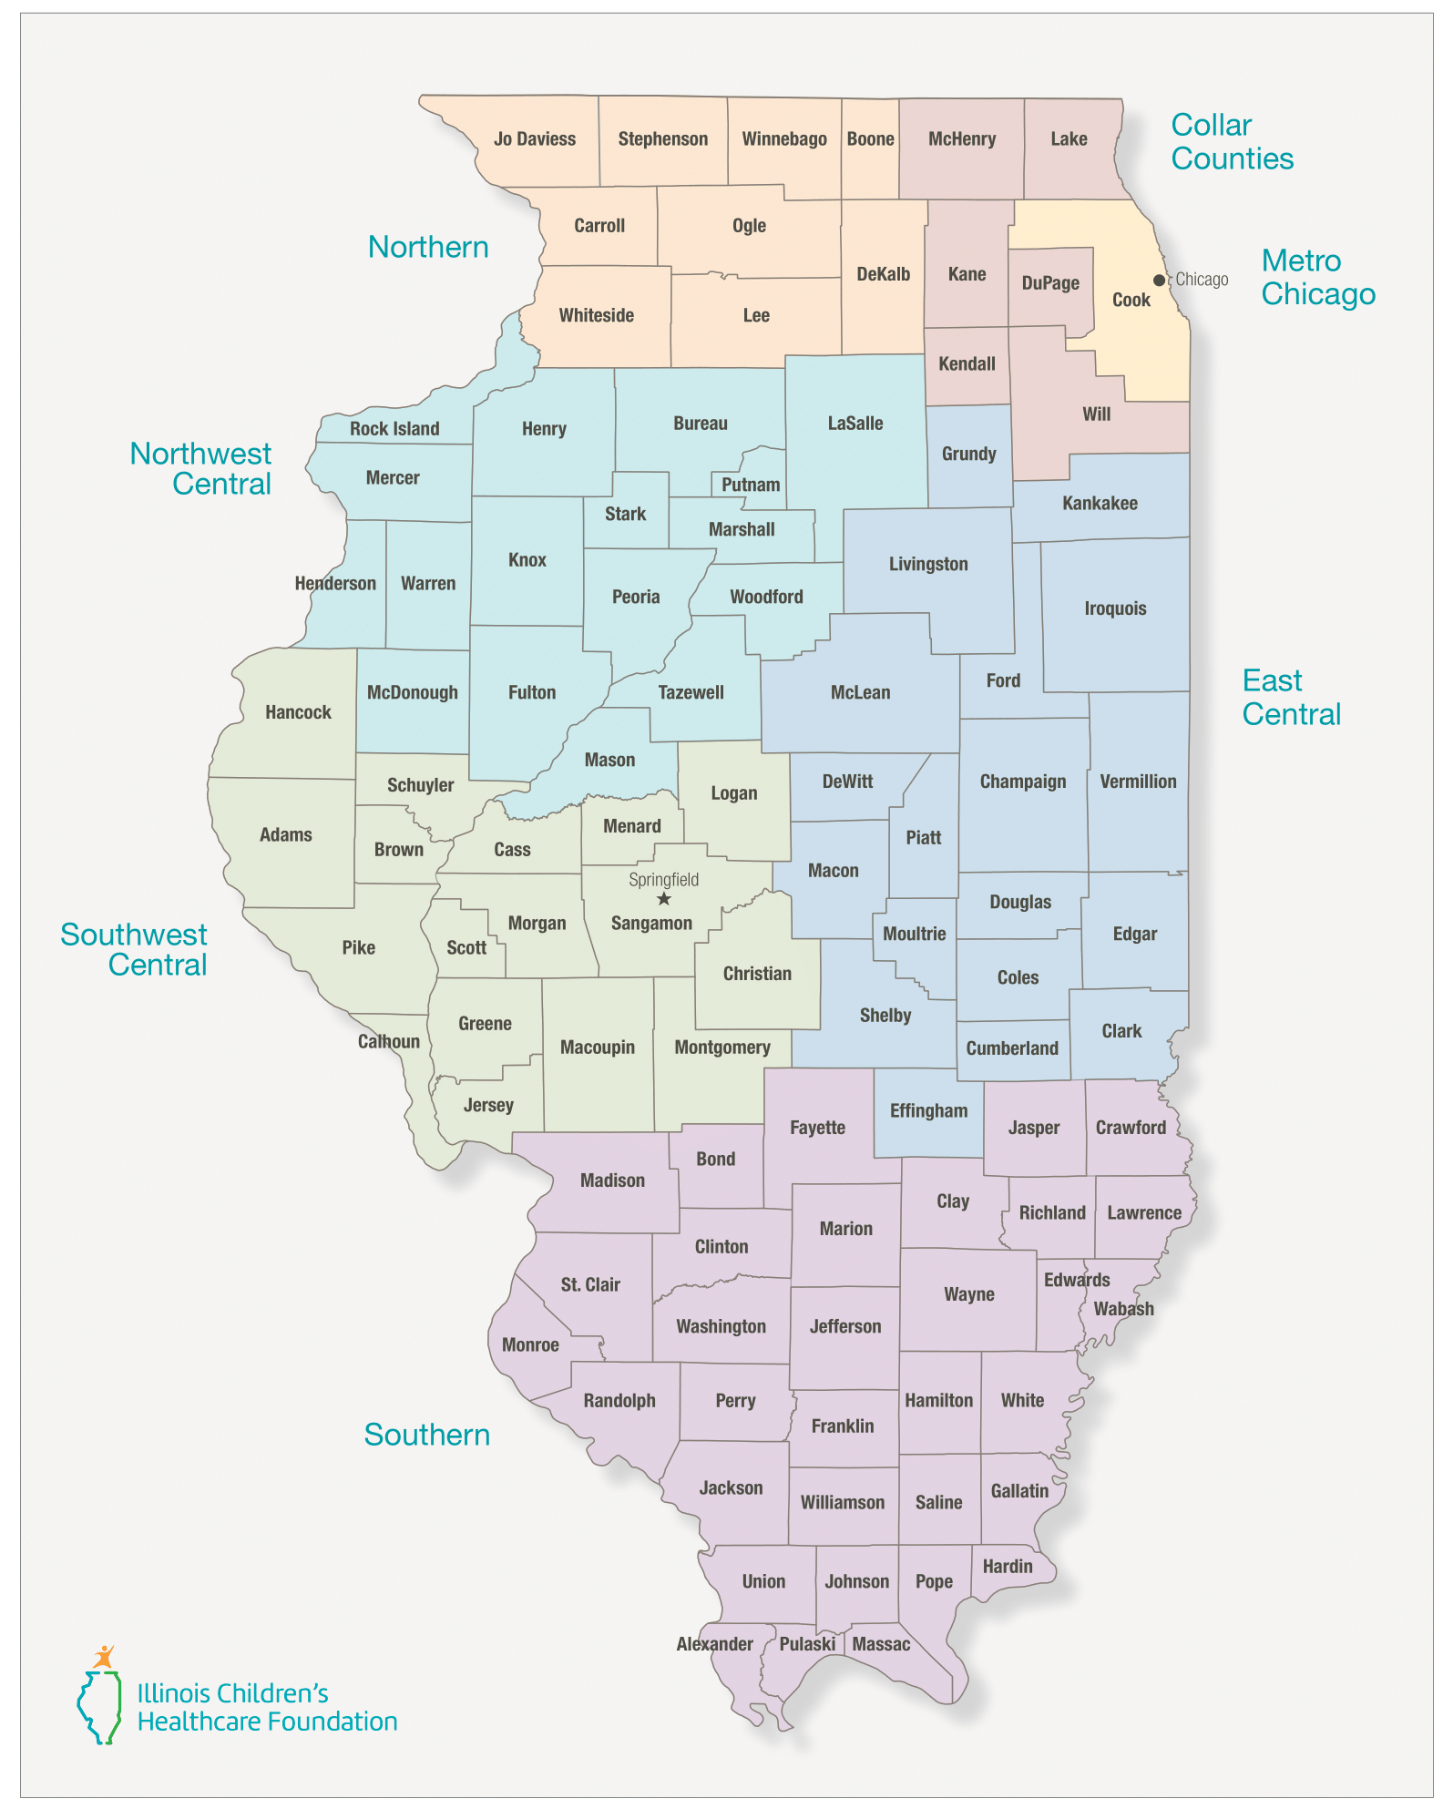
Funding Opportunity Details & Eligibility Requirements
ILCHF anticipates awarding 10 children’s mental health focused and 10 children’s oral health focused grants.
ILCHF also intends to award at least two grants in each of the seven ILCHF funding regions.
Only one application will be accepted per organization.
Notes:
(Zach)
ILCHF intends to award 20 three-year grants of up to $300,000 each through this initiative. In recognition of the importance of advancing both children’s mental and oral health, ILCHF anticipates awarding approximately 10 grants focused on children’s mental health and 10 grants focused on children’s oral health. Applications that propose strategies integrating both mental and oral health will also be considered, which could result in fewer grant awards being made exclusively to either focus area.
Additionally, ILCHF intends to ensure geographic representation across its seven funding regions by awarding at least two grants in each region. To promote equitable access to funding opportunities, only one application will be accepted per organization.

Slide 14

Funding Opportunity Details & Eligibility Requirements
Preference may be given to organizations:
  Serving a federally designated Mental or Dental Health Professional Shortage Area.
    Go to Data.HRSA.gov to learn if your county is located in a HPSA.
  With demonstrated experience in coordinating, co-location, and collaborating with organizations to expand service utilization of mental and oral health services by children and families.
  That bill Medicaid for over 50% of children’s mental health or oral health services.
Notes:
(Zach)
Please note that preference may be given to organizations:
Serving a federally designated Mental or Dental Health Professional Shortage Area. To learn if your county is located in a HPSA, go to Data.HRSA.gov.
With demonstrated experience in coordinating and collaborating with organizations to expand service utilization by children and families to mental health or oral health services. That includes establishing linkages between services in co-located settings, enhancing referrals to providers, etc.
That bill Medicaid for over 50% of children’s mental health or oral health services.

Slide 15

Reporting Requirements & Other Details
Grant recipients will be announced in August 2026.
Grant funds will be distributed using the following timeline:
Payment #1 on or before October 15, 2026
Payment #2 on or before October 15, 2027
Payment #3 on or before October 15, 2028
Grant period must be from:
November 1, 2026 – October 31, 2029
Three Reporting Requirements:
Progress Report on November 30, 2027
Progress Report on November 30, 2028
Final Report on January 31, 2030
Notes:
(Zach)
Grant recipients will be announced in August. There will be three payments associated with this grant. The first payment will occur on or before October 15, 2026 with subsequent payments occurring on October 15, 2027 and October 15, 2028.
The grant period will be from November 1st, 2026 – October 31st, 2029. The grant period cannot begin prior to November 1, 2026, to account for the administrative processing and disbursement of grant funds to an organization following the proposal’s approval by the ILCHF Board of Directors.
There will be 3 reporting requirements associated with this grant. A progress report delineating activities, requested project data, and expenditures will be due on November 30, 2027. A second progress report will be due on November 30, 2028. A final report will be due on January 31, 2030.

Slide 16
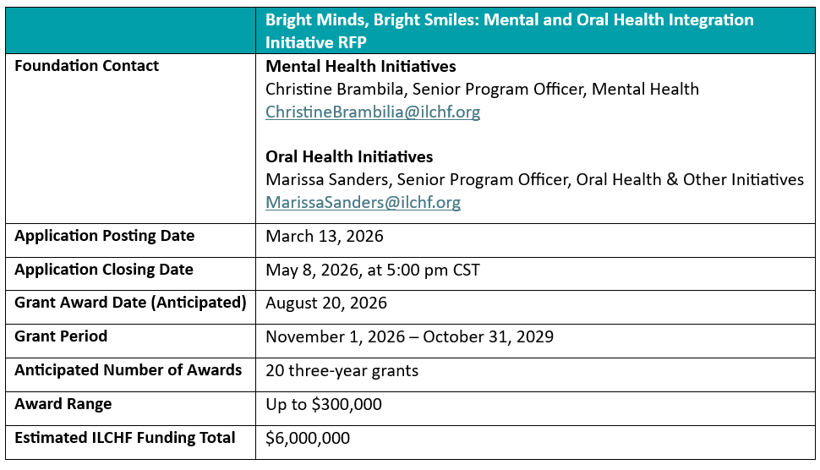
Bright Minds, Bright Smiles RFP Summary
Notes:
(Zach)
This table summarizes the logistical information related to this funding opportunity. All applications will be due by Friday, May 8, 2026 at 5:00pm CDT.

Slide 17
Technical Assistance
For questions related to the “Bright Minds, Bright Smiles: Mental and Oral Health Integration Initiative” RFP, please contact:
Marissa Sanders, Senior Program Officer, Oral Health & Other Initiatives, MarissaSanders@ilchf.org
For RFP questions specifically related to mental health, please contact:
Christine Brambila, Senior Program Officer, Mental Health, ChristineBrambila@ilchf.org
For technical assistance related to this RFP, please contact:
Zach Wilder, Program Officer, Children’s Health, ZacharyWilder@ilchf.org
Notes:
(Zach)

Slide 18
Application Process
Notes:
(Zach)
Before we move to a Q&A session I wanted briefly discuss the application process for this RFP.

Slide 19

Prior to Starting the Application Process
Be sure you have read the RFP thoroughly and are certain your organization and/or initiative qualify for the funding being offered.
Make sure you have your organization’s Employer Identification Number (EIN) from either the most recent IRS Form 990 or IRS Determination Letter.
If you encounter any challenges, please contact Zach Wilder at ZacharyWilder@ilchf.org
Notes:
(Zach)
Prior to beginning the online application process:
Be sure you have read the RFP thoroughly and are certain your organization and/or initiative qualify for the funding being offered.
Make sure you have your organization’s Employer Identification Number (EIN) from either the most recent IRS Form 990 or IRS Determination Letter ready when you enter the system. You will need it to establish your application file.
If you do not have an EIN because, for example, you are not a non-profit organization, please contact me at ZacharyWilder@ilchf.org so that we can discuss alternative options to access the application.

Slide 20
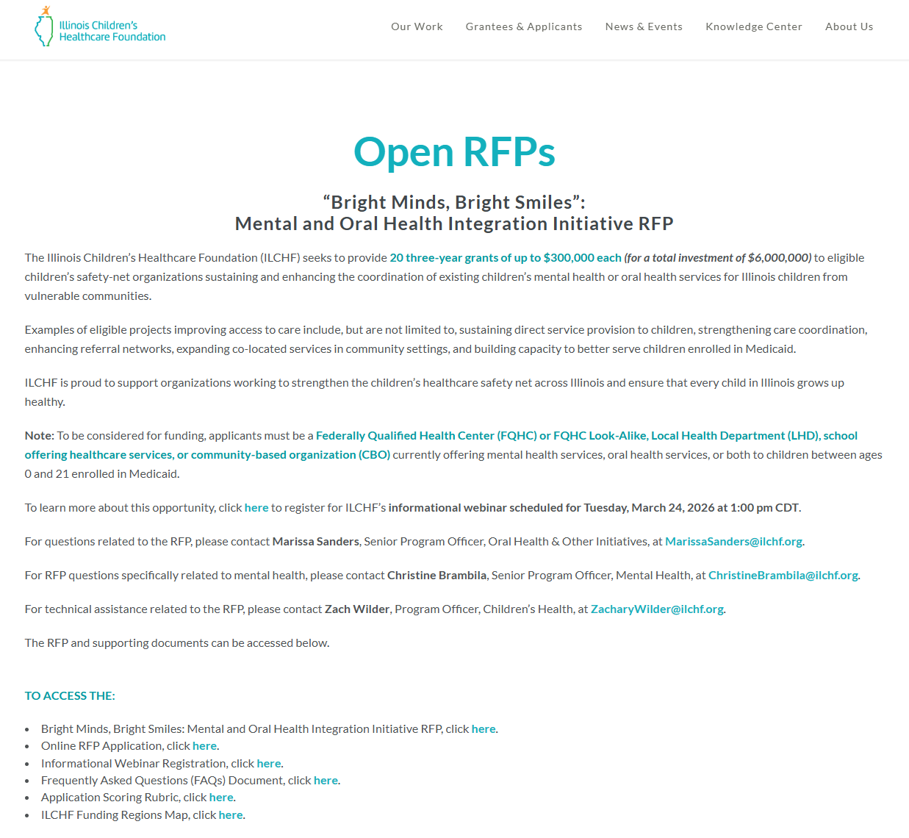
Accessing the Application
1.
1. Go to ILCHF.org
2. Click “Grantees & Applicants”
3. Select “Open RFPs”
4. Scroll to the “Bright Minds, Bright Smiles: Mental and Oral Health Integration Initiative”
5. Click “Online RFP Application”
2.
Notes:
(Zach)
To access the application, go to ILCHF.org, click grantees & applicants at the top of the screen, and then select Open RFPs. Once on the Open RFPs page scroll down to the “Bright Minds, Bright Smiles” initiative and click “On-Line RFP Application.”

Slide 21
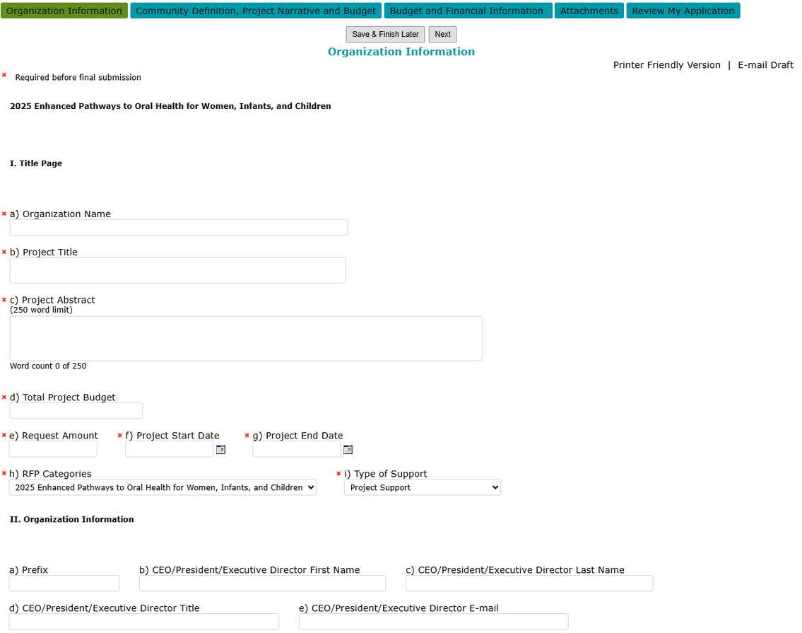
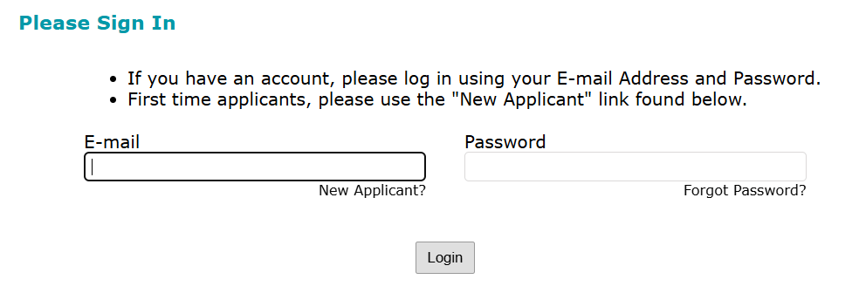
Accessing the Portal
1.
3.
2.
Notes:
(Zach)
Once you access the portal, you will be prompted to enter log-in information. If you are a returning applicant with an account you can simply enter your email address and password. If you are a new applicant you can select “New Applicant” which will bring you to a page where you can set up an account. Please note that only one person can access the application per organization and enter information in our online portal.
After entering this information you will be brought to the next screen where you will be asked to enter your tax id. This is how we can ensure that only one applicant is the lead per application.
Once that information is entered you will be brought to the next screen where you will gain access to the online application portal. As you can see, there are tabs for you to navigate and enter the requested information on the webpage. Note that there is an option to save and continue working on the application at a later time. You will also be able to review the total application prior to submitting.

Slide 22

Core Components of the Application
1. Title Page & Organization Information
2. Project Details
3. Budget Narrative
4. Attachments
Notes:
(Zach)
Applicants will be required to complete the following sections
O Organization information, including a brief project abstract, organizational background, and contact information.
O A project details section that includes information about the community you serve, the need your project will address, and how funding for this grant will be utilized during the grant period
O Budget and budget narrative
O And then additional supplemental materials and financial information

Slide 23
Application Process – Project Details
Primary geographic area served
Please list all the counties included in the catchment area of the population you intend to serve
Primary age group served
Describe the demographics of the community to be served (250-word limit)
Notes:
(Zach)
Community Definition – “Please select the most appropriate designations for proposed work and the populations you plan to serve.”
Primary Geographic Area served – “Please select one option that best represents the area served.”
Please list all the counties included in the catchment area of the population you intend to serve.
Primary Age Group – “Indicate if the request is intended to primarily serve one of the age groups listed or will serve multiple age groups within the category. If the request will not directly serve children, then please select “not applicable.” A full description can be provided below.
None
Infants/Toddlers (0-5)
Children (6-13)
Adolescents (14-18)
Young Adults (19-21)
Multiple
Not applicable
Describe the demographics of the community to be served. Data provided could include, but is not limited to, socioeconomic status, number of students with IEPs, languages spoken, insurance coverage, unemployment, school district spending per pupil, population density, and age distribution. Discuss relevant health data if known for children and adults, substance use, average wait times for behavioral health services, etc. (250-word limit)

Slide 24
Application Process – Project Details
Focus Area:
  Mental Health
  Oral Health
  Both Oral Health and Mental Health
Program Area:
  None
  Advocacy/Policy
  Direct Service
  Education
  Other
  Workforce Development
  Research / Evaluation
  Planning
Notes:
(Zach)
Focus area – “Select the Focus Area that best describes the main focus of your project.”
Mental Health
Oral Health
Both Oral Health and Mental Health
Program area - Select the Program Area that best describes the primary activity of your project.
None
Advocacy/Policy
Direct Service
Education
Other
Workforce Development
Research/Evaluation

Slide 25
Application Process – Project Details
Population Served – number of unduplicated children and adults to be served by this grant annually once fully operational.
Please describe the current children’s mental health and/or oral health services your organization provides (250-word limit)
Please describe the need that your project will address. Be concise using potential sources of statistics/research specific to your geographic area and proposed population only (250-word limit)
Please describe the work you will do to address the need outlined above. Please describe how grant funding will be used to sustain and/or expand existing children’s mental and/or oral health services. (500-word limit)
Notes:
(Zach)
Population Served. Number of unduplicated children to be served by this grant annually once fully operational. If applicable, please indicate numbers of unduplicated adults to be served as well.
Project Narrative
Please describe the current children’s mental health and/or oral health services your organization provides. (250-word limit)
Please describe the need that your project will address. Be concise using potential sources of statistics/research specific to your geographic area and proposed population only. (250-word limit)
Please describe the work you will do to address the need outlined above. Please describe how grant funding will be used to sustain and/or expand existing children’s mental and/or oral health services. (500-word limit)

Slide 26
Application Process – Project Details
Please describe the site where mental and/or oral health services will be sustained or expanded including a description of co-located services, if appropriate. Additionally, please indicate the proposed staffing model and plans for recruitment of staff. (150-word limit)
Please describe how you will track the progress of the project, the timing involved, and how you will incorporate new learning into the project’s design. (150-word limit)
Please describe any established strategic partners and potential partners you will work with for the project and describe how they will be involved. (250-word limit)
Notes:
(Zach)
Please describe the site where mental and/or oral health services will be sustained or expanded including a description of co-located services, if appropriate. Additionally, please indicate the proposed staffing model and plans for recruitment of staff. (150-word limit)
Please describe how you will track the progress of the project, the timing involved, and how you will incorporate new learning into the project’s design. (150-word limit)
Please describe any established strategic partners and potential partners you will work with for this project and describe how they will be involved. (250-word limit)

Slide 27
Application Process – Project Details
Please describe how you envision the project, once developed, being sustained over the long-term utilizing existing infrastructure. (150-word limit)
If another fund decides to partner in terms of funding applications, we would like to have the ability to share your application with them. We will not share your application without your permission to do so. Please select the response which reflects your level of interest in providing permission for us to share your application with an interested funder.
  Please do not share our application.
  Please share our application.
  Please contact us to discuss the possibility of sharing our application.
Notes:
(Zach)
Please describe how you envision the project, once developed, being sustained over the long-term utilizing existing infrastructure. (150-word limit)
If another fund decides to partner in terms of funding applications, we would like to have the ability to share your application with them. We will not share your application without your permission to do so. Please select the response which reflects your level of interest in providing permission for us to share your application with an interested funder.
Please do not share our application.
Please share our application.
Please contact us to discuss the possibility of sharing our application.

Slide 28
Application Process – Budget Narrative
Complete ILCHF’s three-year budget template. Examples of eligible costs include:
  Staff time to develop and/or administer program
  Professional development and other training expenses
  Travel time
  Meeting expenses
  Communication expenses
  Materials/supplies
  Equipment
Provide a budget narrative. Delineate details associated with the budget, clarify the calculations leading to the budget numbers, and provide details that do not fit within the budget template.
Notes:
(Zach)
With regards to the budget, we will ask that you complete ILCHF’s three-year budget template detailing how ILCHF grant funding will be used throughout the grant period. Examples of eligible costs include: staff time to develop and/or administer program, professional development and other training, travel time, meeting expenses, communications expenses, materials/supplies, and equipment.
Then, please provide a budget narrative that delineates details associated with the budget, clarifies calculations leading to the budget numbers, and provides details that do not fit within the budget template. For every line item that you are requesting funds for there should be an explanation as to how those funds will be used.

Slide 29
Application Process - Attachments
3-Year Budget Template
The Officer’s Certification Form signed by the CEO/President or Department Chair – this document can be downloaded from the ILCHF website here.
Applicant’s IRS Exemption Letter
Applicant’s Most Recent Form 990
Applicant’s Most Recent IL-AG 990
Applicant’s Most Recent Audited Financial Statements
Board of Directors list for applicant organization
*If one or more documents are not applicable for your organization, please attach a note in its place explaining why the document cannot be provided.
Notes:
(Zach)
Finally, we will ask that you submit a:
Aforementioned 3-year budget template
Officer’s Certification Form signed by the CEO/President or Department Chair
IRS Letter of Exemption indicating you are a non-profit organization
Most recent IRS Form 990
Most recent AG IL 990
Most recent audited financial statements
Board of Directors list for applicant organization
If any of these items do not apply to your organization, please attach a note in its place that briefly explains why the document won’t be provided.

Slide 30
Questions & Answers
Notes:
(Zach)
We will now transition into the Q&A portion of today’s info-session. As a reminder, questions can be submitted to the Q&A box located at the bottom of the screen. And as you begin to type your questions, we wanted to review a few frequently asked questions that we have already received or anticipate receiving related to this funding opportunity.

Slide 31
Frequently Asked Questions
My organization does not currently offer mental health services or oral health services to children in Illinois. Am I eligible to apply?
  No. This funding opportunity is not available to organizations that do not currently offer mental health services or oral health services in Illinois.
Does the organization have to serve the entire ILCHF funding region?
  No. The goal is to fund organizations located and/or operating across each ILCHF funding region. Activities may be focused on a particular geographic area, county, or community.
My organization provides mental health or oral health services to Medicaid eligible, or uninsured children but we do not currently bill Medicaid. Is my organization eligible for this RFP?
  Yes. You are not required to bill Medicaid to be an eligible organization. Your application should demonstrate that you provide services to children enrolled in Medicaid.
What is the maximum amount of funding that can be allocated towards indirect costs?
  Grant applicants may request up to 15% of total projected grant expenditures be allocated towards indirect costs. Applicants will be asked to outline the specific indirect costs that grant funding is requested to support in the budget narrative.
Notes:
(Zach)
My organization does not currently offer mental health services or oral health services to children enrolled in Medicaid in Illinois. Am I eligible to apply?
- This funding opportunity is not available to organizations that do not currently offer mental health services or oral health services to children enrolled in Medicaid in Illinois. Organizations are not required to currently offer both oral health and mental health services to be eligible to apply.
Does the organization have to serve the entire ILCHF funding region?
No. The goal is to fund organizations located and/or operating across each ILCHF funding region. Activities may be focused on a particular geographic area, county, or community.
My organization provides mental health or oral health services to Medicaid eligible, or uninsured children but we do not currently bill Medicaid. Is my organization eligible for this RFP?
- Yes. You are not required to bill Medicaid to be an eligible organization. Your application should demonstrate that you provide services to children enrolled in Medicaid.
What is the maximum amount of funding that can be allocated towards indirect costs?
- Grant applicants may request up to 15% of total projected grant expenditures be allocated towards indirect costs. Applicants will be asked to outline the specific indirect costs that grant funding is requested to support in the budget narrative.

Slide 32
Frequently Asked Questions
Please explain the application review process:
  Reviewed by ILCHF staff.
  Subset of applications are forwarded to respective members of ILCHF’s Grants Committee.
  Members evaluate, score, and provide preliminary funding recommendations using a standardized rubric.
  Recommendations regarding funding or declining each application presented to the Grants Committee. Grants Committee determines which applications to recommend for funding and which to recommend for declination.
  Final recommendations presented to the ILCHF Board of Directors in August 2026.
Notes:
(Zach)
Please explain the application review process:
Applications will first be reviewed by ILCHF staff to ensure compliance with the eligibility criteria and submission requirements outlined in the RFP. Following this initial review, a subset of applications will be forwarded to respective members of ILCHF’s Grants Committee for further evaluation. Grants Committee members will then evaluate, score, and provide preliminary funding recommendations for the applications assigned to them using a standardized rubric developed specifically for this initiative.
Recommendations regarding funding or declining each application will be presented to the Grants Committee. The Grants Committee will determine which applications to recommend for funding and which to recommend for declination, and those recommendations will be presented to the ILCHF Board of Directors for final funding decisions at its Board meeting scheduled for August 2026.

Slide 33
Thank you!
Any questions?

